Slide 1
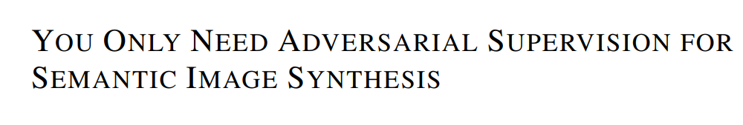
ICLR 2021
Jeonbuk National University
Multimedia Lab Under Prof. Park and Prof. Yoon
Mingle Xu
14 Jan 2021

Slide 2
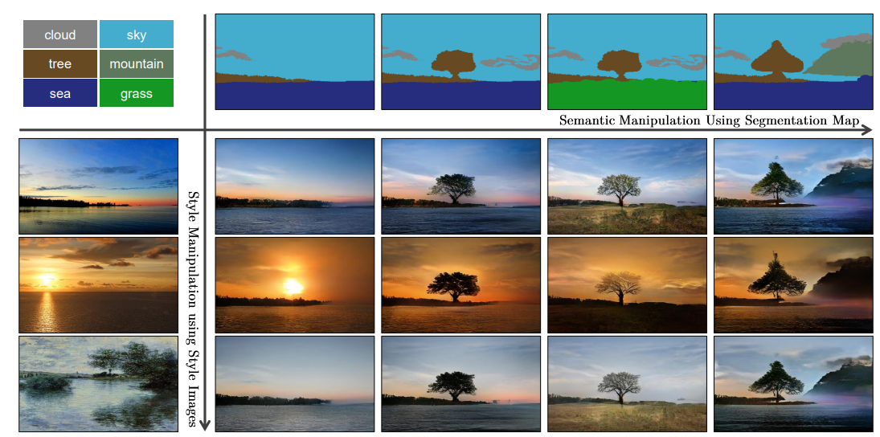
Related Work: from semantic segmentation to image

Slide 3
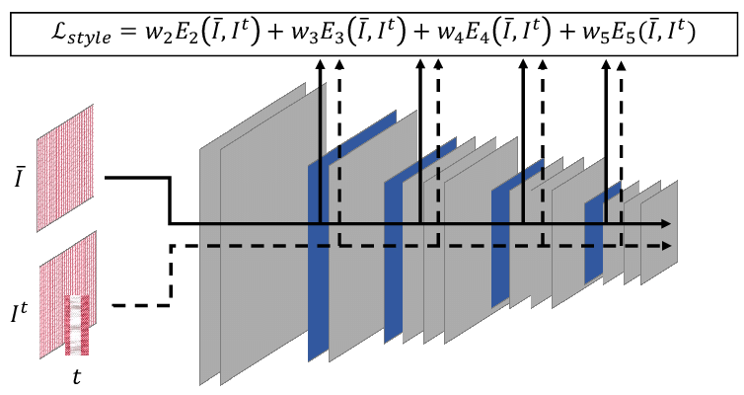
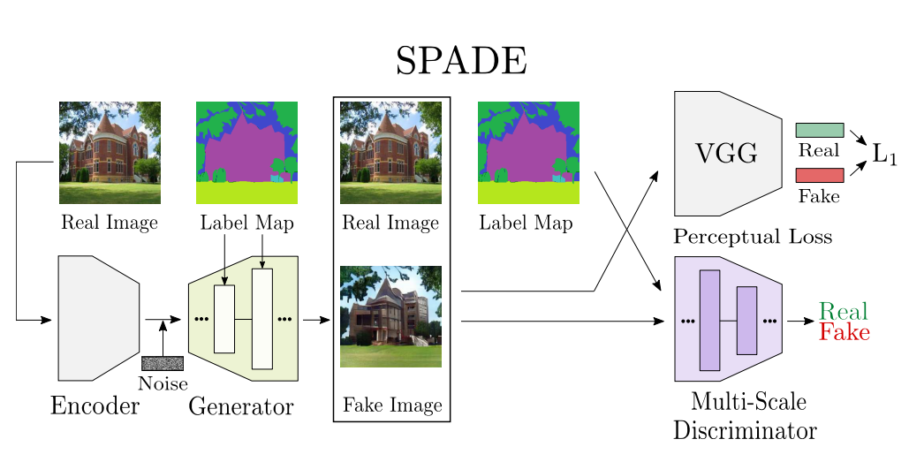
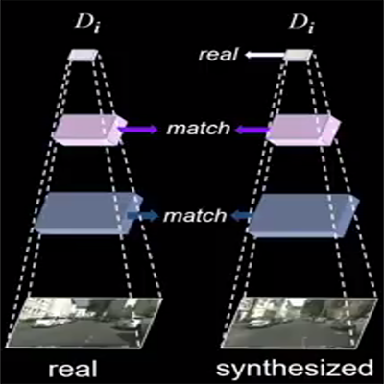
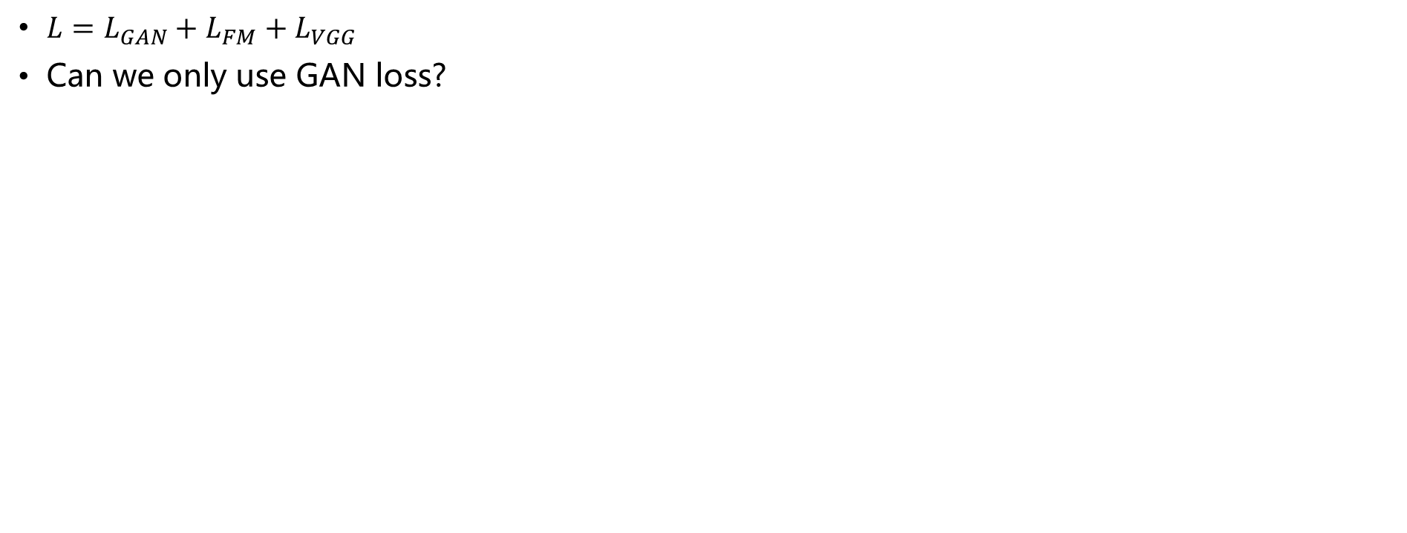
Related Work: loss functions
$L=L_{GAN}+L_{FM}+L_{VGG}$
Can we only use GAN loss?

Slide 4
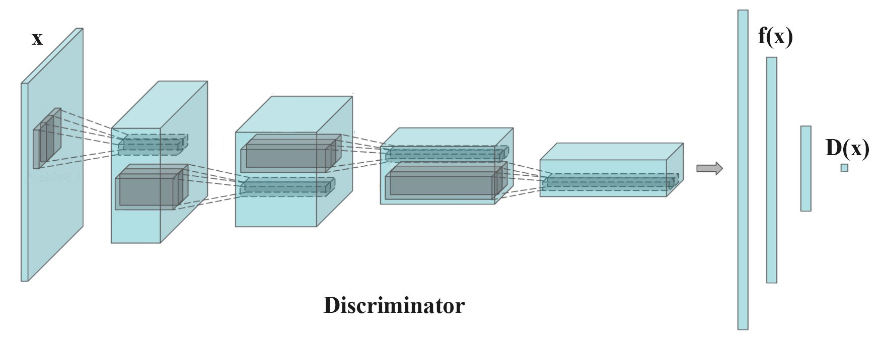
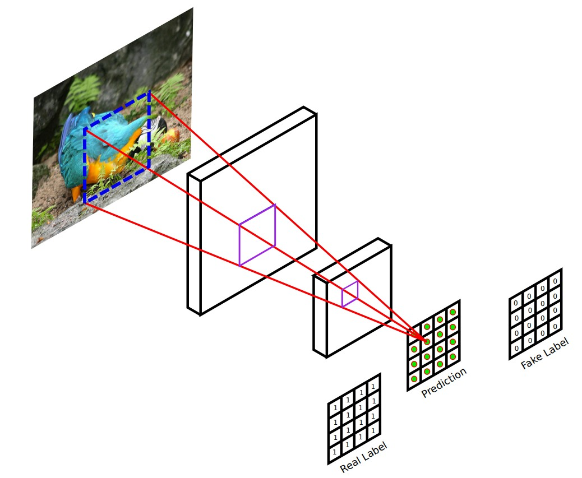
Related Work: architecture of discriminator
Image (H,W,3)
Segmentation (H,W,1)
Concatenation (H,W,4)
Patch GAN v.s. Scalar GAN
Multi-scale

Slide 5
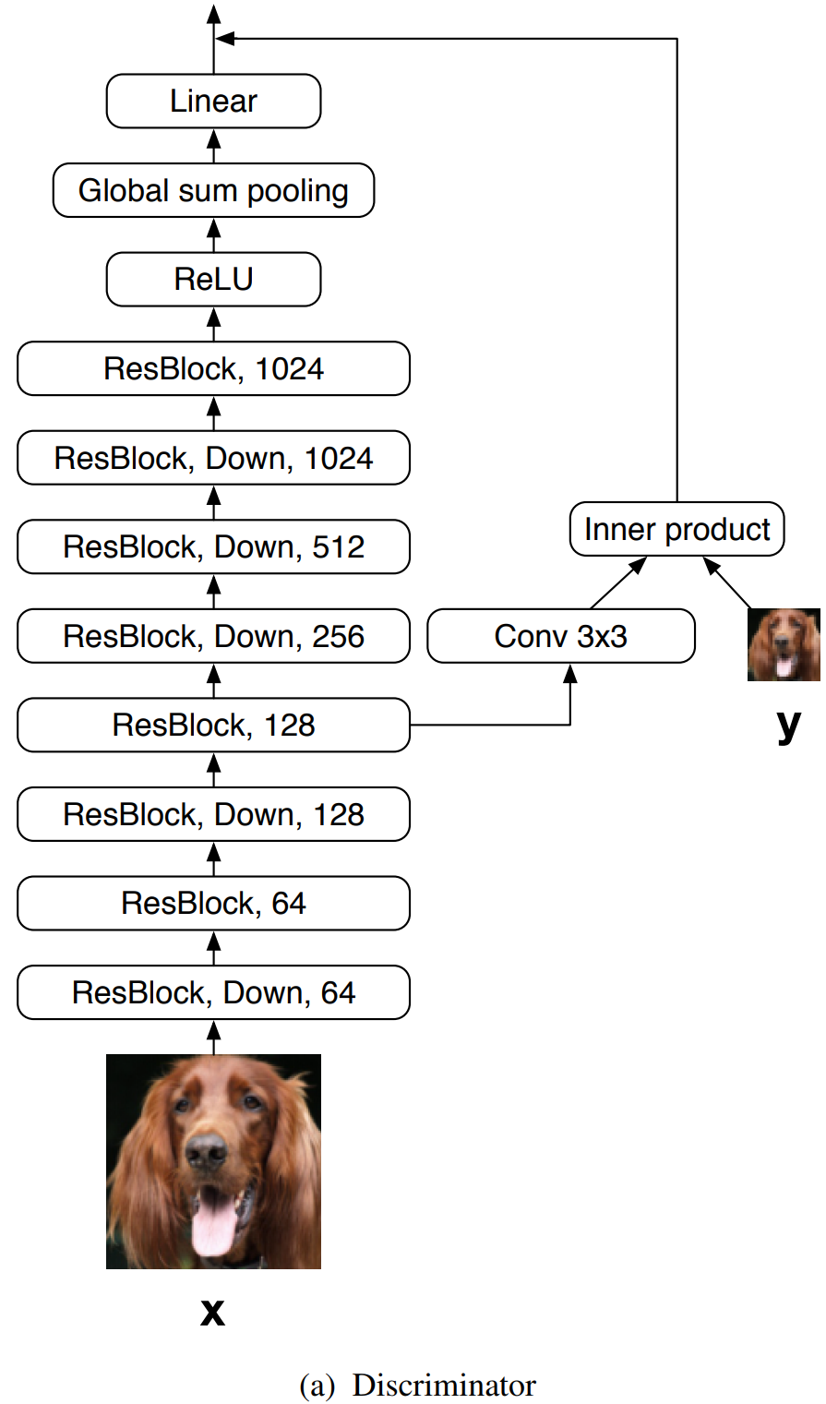
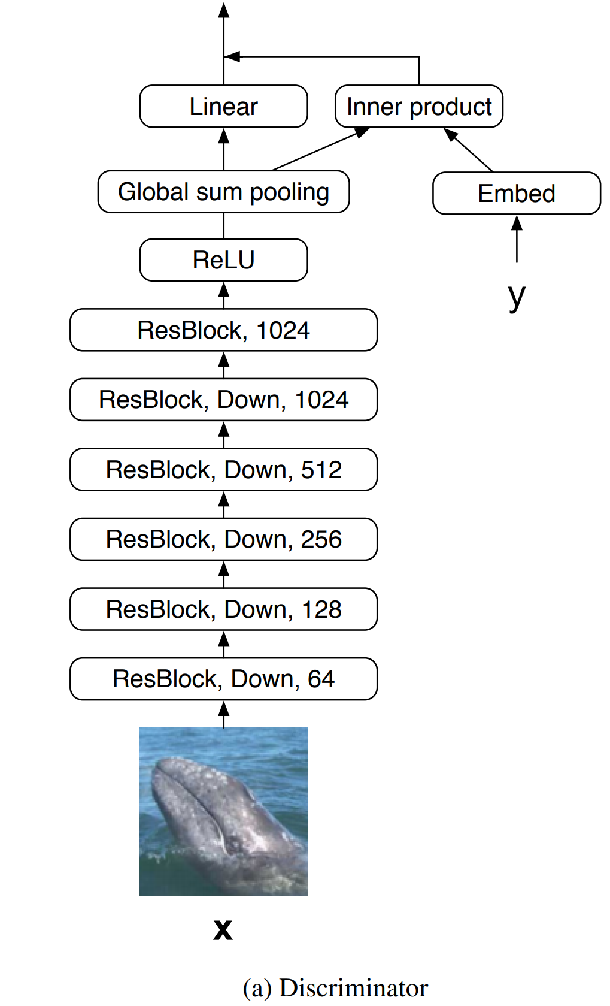
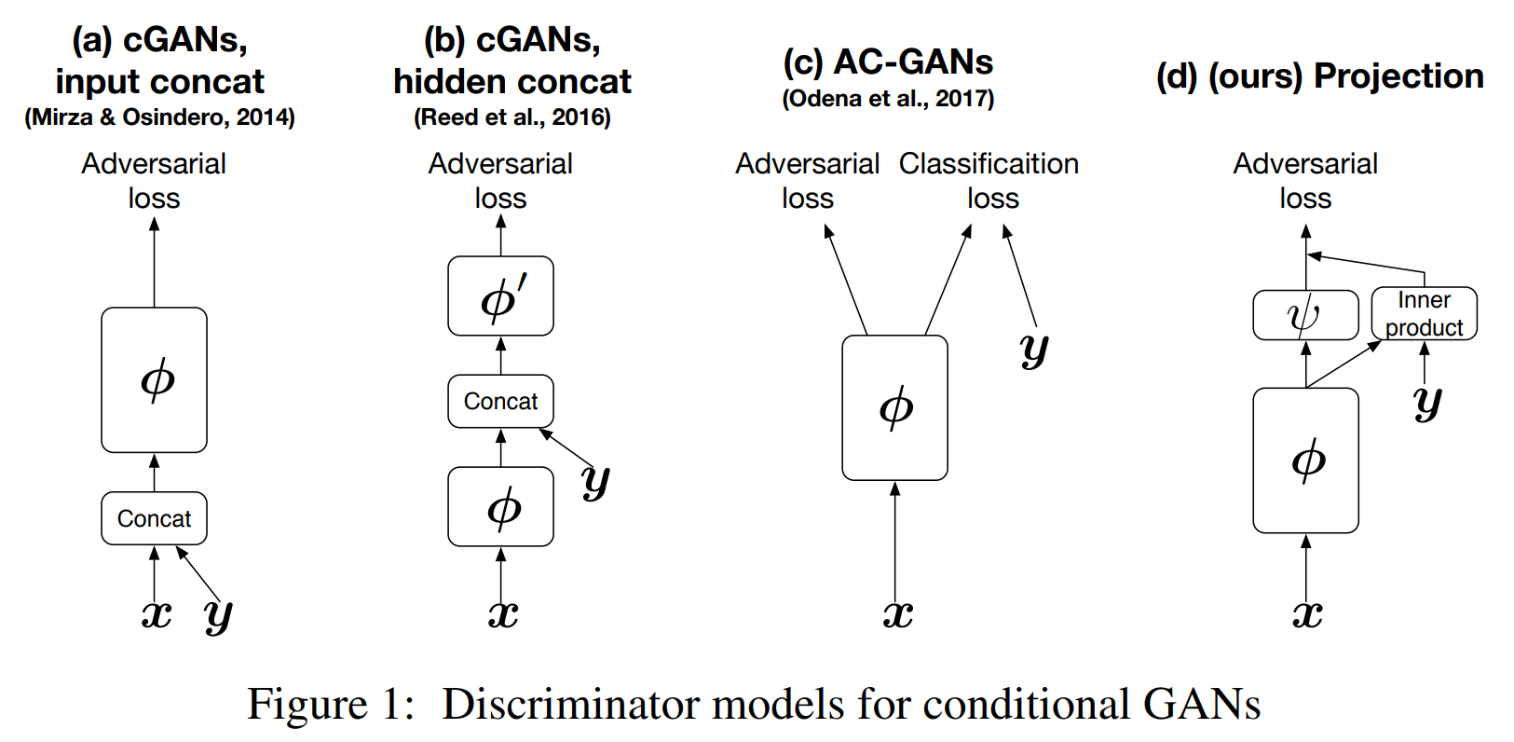
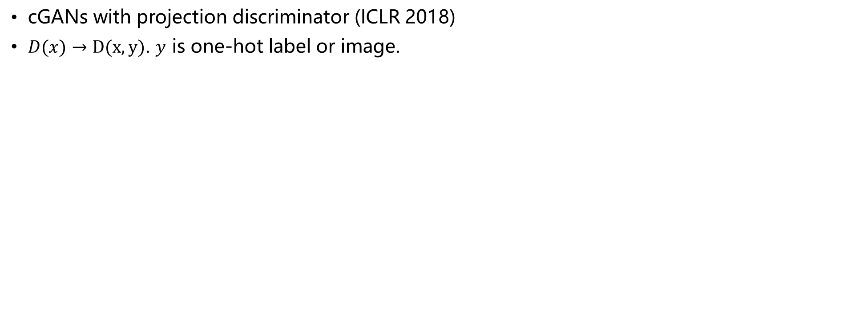
Related Work: how to do conditional image generation
cGANs with projection discriminator (ICLR 2018)
$D(x)→D(x,y)$. $y$ is one-hot label or image.
For label-based
image generation
For super-resolution

Slide 6
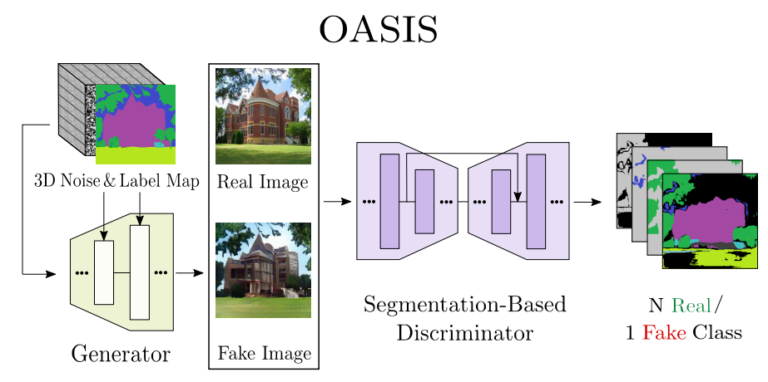
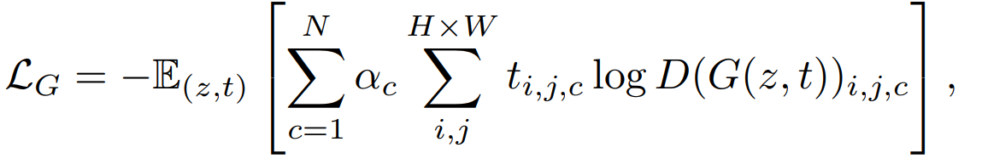
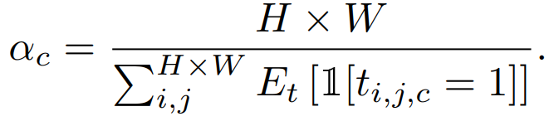
Proposed Algorithm
Align semantic label and image
Pixel-level classification for real image
Frequency of every label

Slide 7
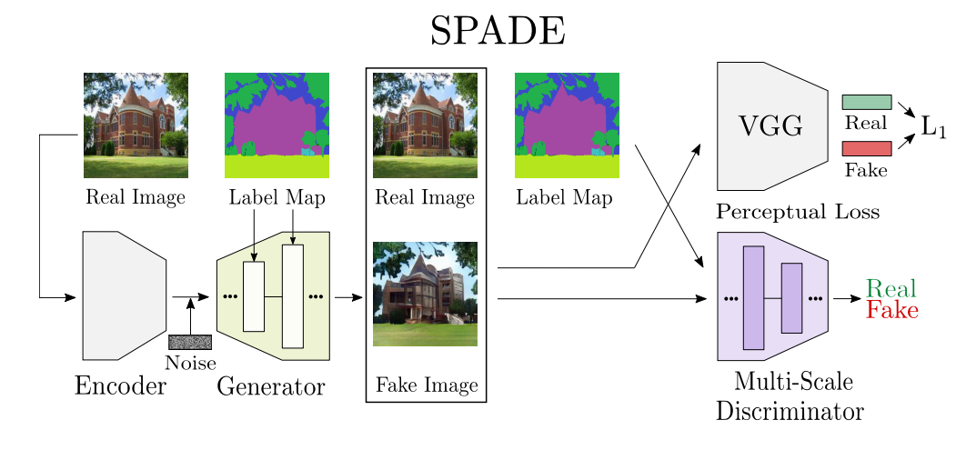
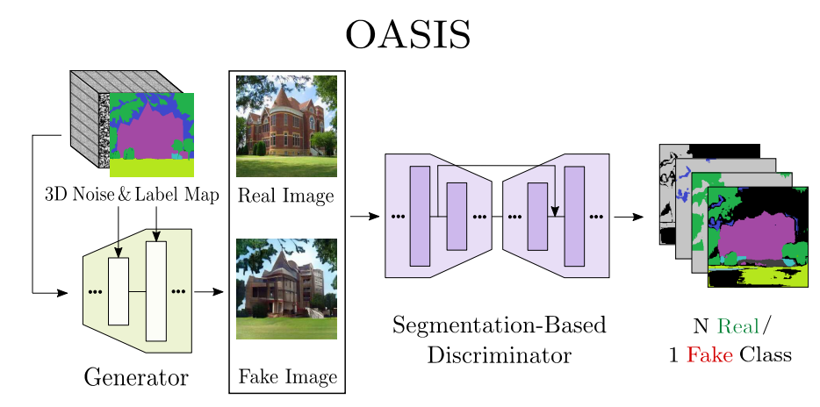
Proposed Algorithm
Multimodal image synthesis

Slide 8
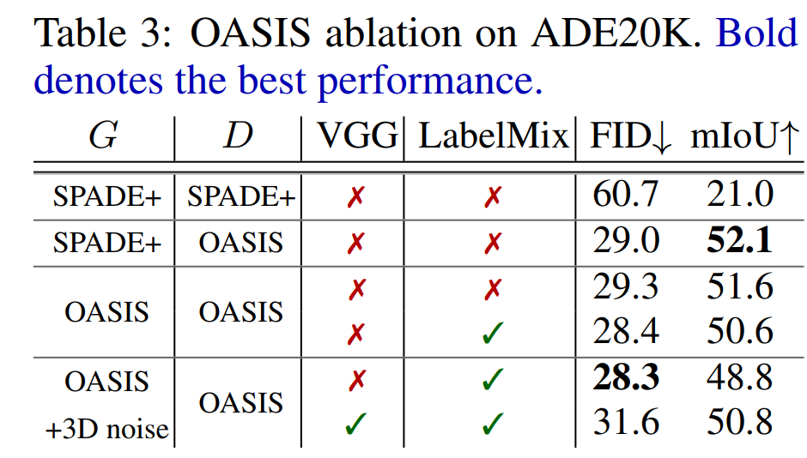
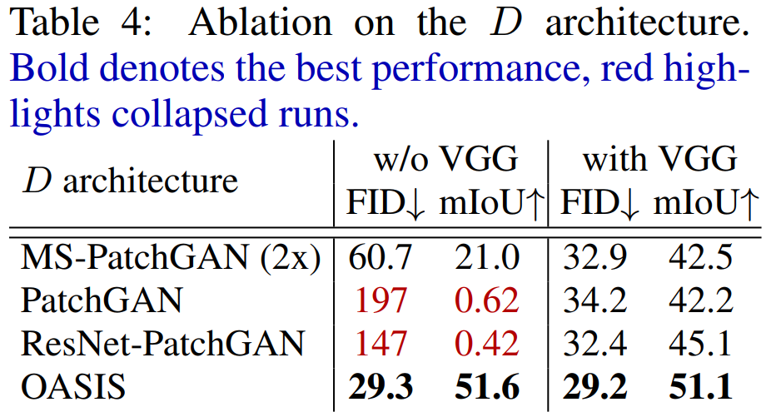
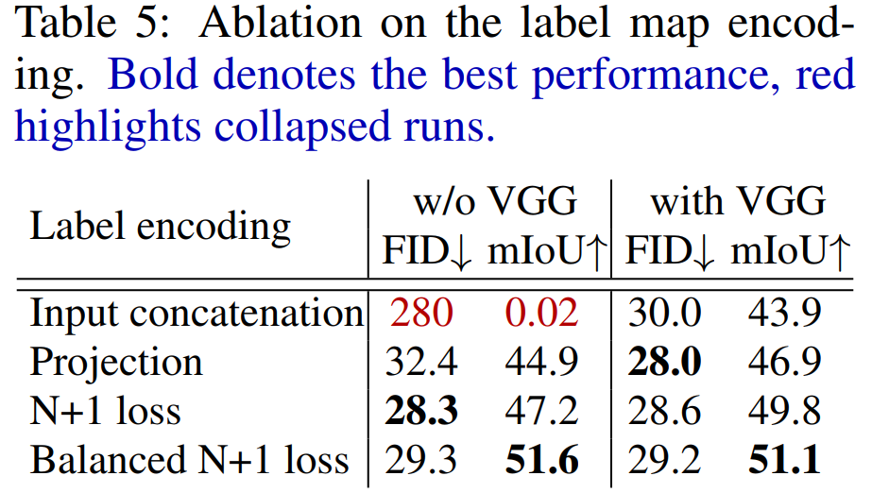
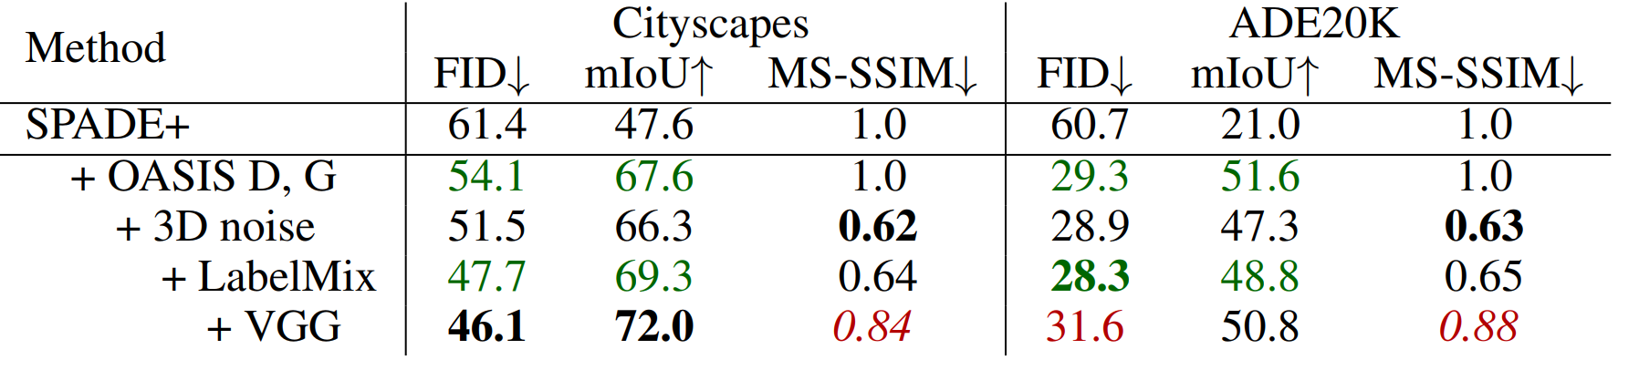
Ablation: discriminator and its architecture

Slide 9
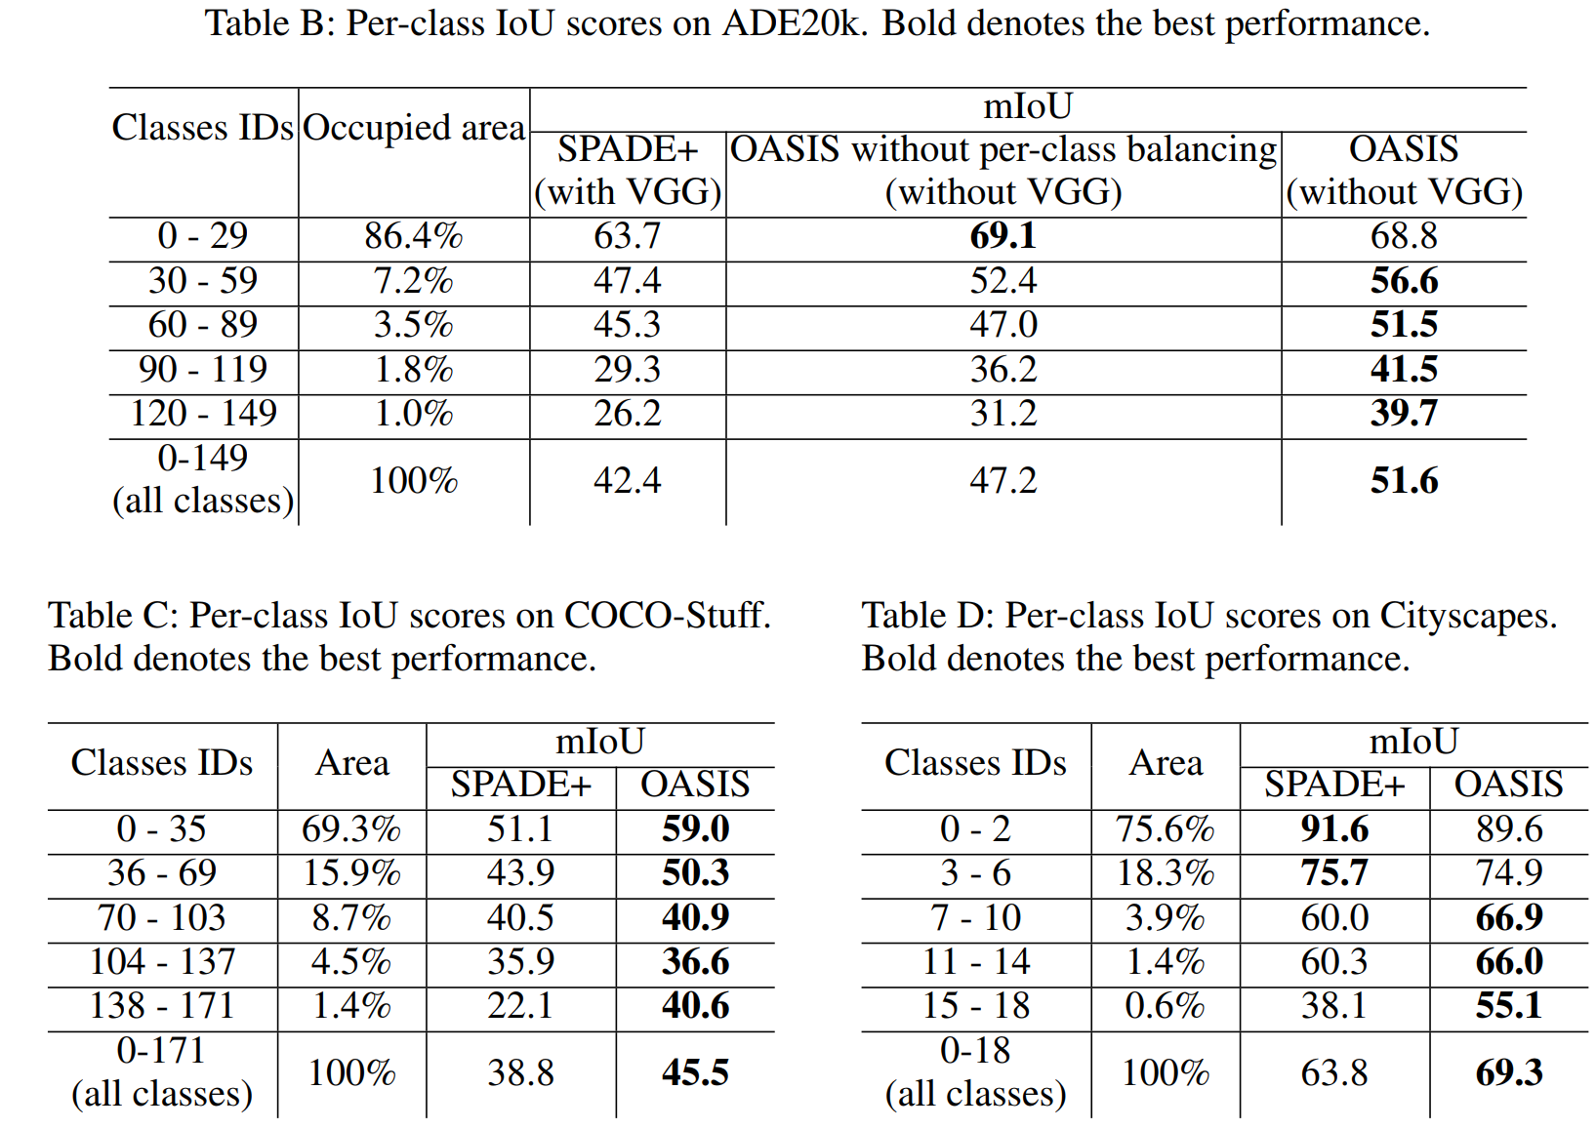
Ablation: label balance

Slide 10
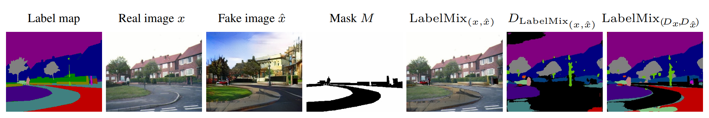
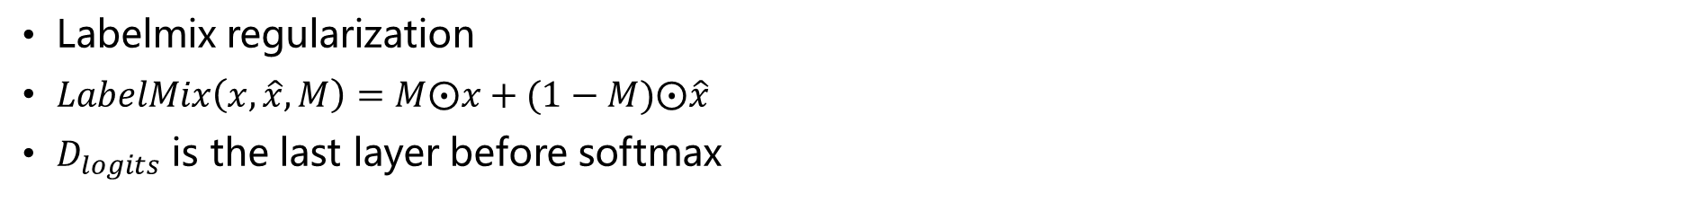
Proposed Algorithm
Labelmix regularization
$LabelMix\left(x,\hat{x},M\right)=M⨀x+(1−M)⨀\hat{x}$
$D_{logits}$ is the last layer before softmax

Slide 11
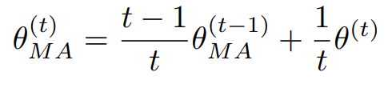
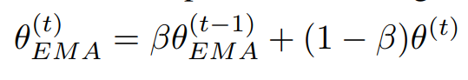
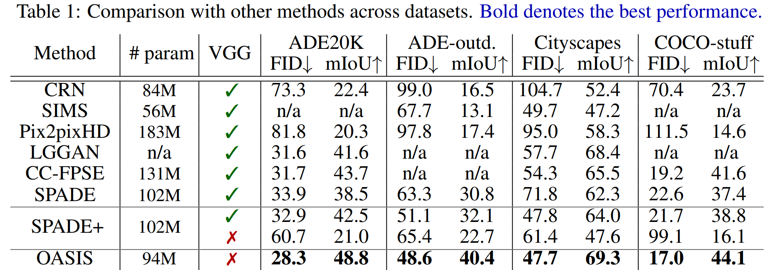
Experiments: comparison to SOTA
SPADE+: adding exponential moving average of parameters.

Slide 12
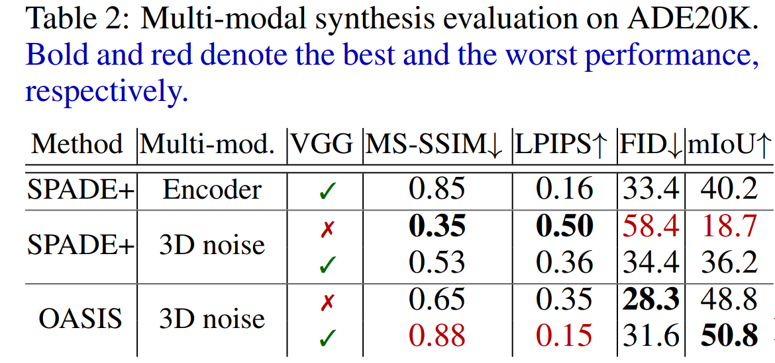
Experiments: multimodal generation
Tradeoff between diversity and quality

Slide 13
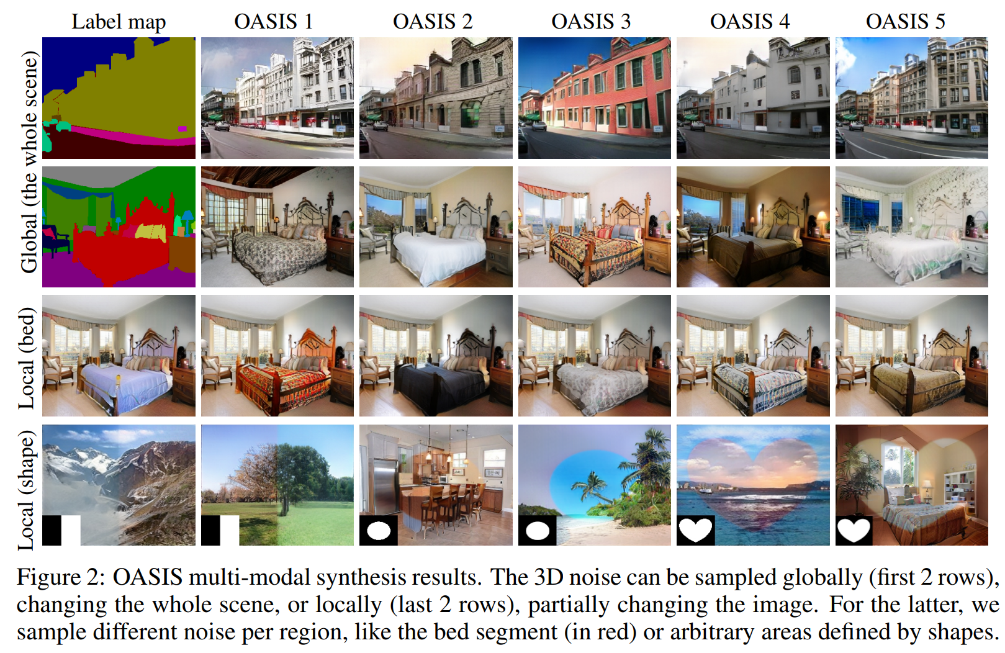
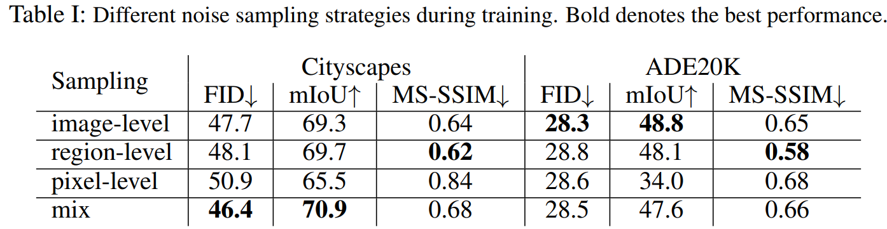
Experiment: multimodal generation

Slide 14
Conclusions
Stronger discriminator:
Spatial and semantic-aware supervision from segmented-based discriminator.

Slide 15
Outline
Proposed
Algorithm
Conclusions
Introduction
Experiments

Slide 16
Introduction

Slide 17
Proposed Algorithm

Slide 18
Experiments

Slide 19
Conclusions

